Slide 1

Ebay Used Car Sales Analysis
Daniel Papp
Erica Graboyes
Colleen Karwoski
Eugenia Volscaia
Tyler Fowler
UofM Data Analytics Bootcamp – Project 1

Slide 2
Executive Summary
As part of our analysis project, we chose to review used car sales on eBay between 2018 and 2020 trying to answer the following:
What specifications of a car impact price the most?
What is the most common price point for a car?
What is the value of car over time by make/model cars?

Slide 3
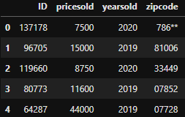
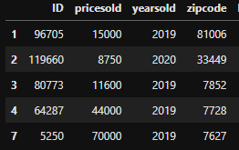
Data Selection & Clean-up
Using Kaggle.com, we selected a dataset that referenced eBay used car sales from 2018-2020
Removed non-numeric characters, filtered for acceptable zip codes; filtered out unusual pricing (<$100), mileage (>400K miles), engine type (>16 cylinders)
Exported data to csv to share with rest of team
Notes:
Talk about functions used
Use of united postal service zip code list

Slide 4
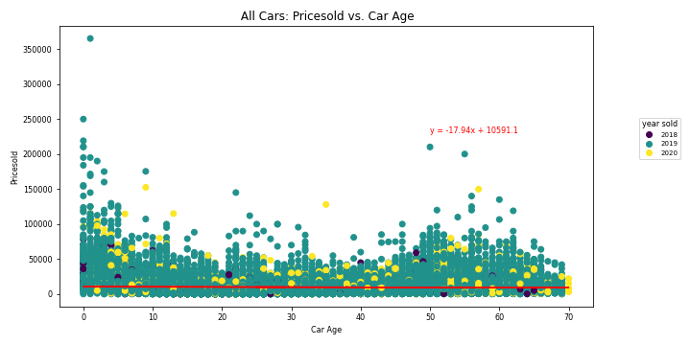
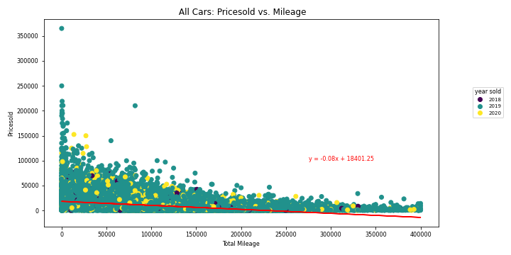
Factors Impacting Car Price
Used linear regression to analyze which factors impact a car’s price
Dependent Variable: used car sales price (“pricesold”)
Independent Variables:
Mileage
Car_Age: difference between year sold & year the car was manufactured
Both linear regression models have very small r-squared scores
Suggests that neither Mileage nor Car Age significantly impact or explain a car’s price
Correlation Coefficient: -0.03
R-squared: 0.0006487313967342179
Correlation Coefficient: -0.45
-R-squared: 0.20213662986300665

Slide 5
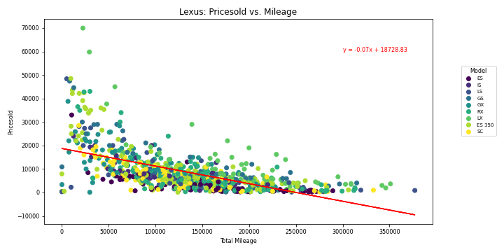
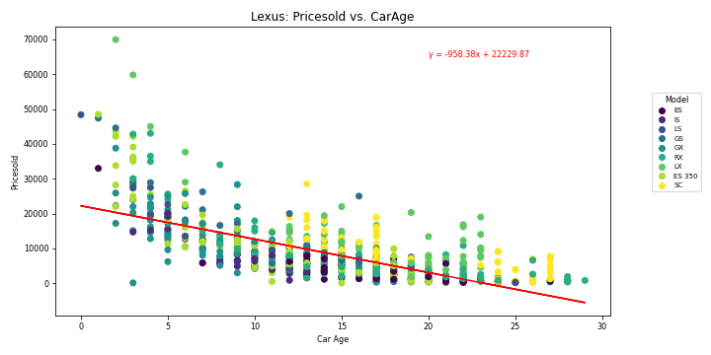
Factors Impacting Car Price – Make Level
Next: Analyzed by make - impact of mileage and age
Analyzing across all makes is not a logical way to examine, understand what impacts price
Make | Rsquared: Miles | Rsquared: Age
Audi | 0.409511 | 0.510402
Subaru | 0.404280 | 0.338325
Honda | 0.402667 | 0.324855
Lexus | 0.370253 | 0.455066
Jeep | 0.353280 | 0.188031
Chrysler | 0.318123 | 0.022158
Toyota | 0.314575 | 0.042049
BMW | 0.311513 | 0.128702
GMC | 0.307132 | 0.236249
Land Rover | 0.283261 | 0.045181
Nissan | 0.254065 | 0.085199
Buick | 0.239962 | 0.008316
Dodge | 0.232637 | 0.016675
Lincoln | 0.224401 | 0.025538
Chevrolet | 0.195182 | 0.017228
Cadillac | 0.188789 | 0.065389
Ford | 0.188606 | 0.001086
Mercedes-Benz | 0.188604 | 0.046032
Porsche | 0.185955 | 0.055338
Pontiac | 0.161867 | 0.131539
Jaguar | 0.152575 | 0.179299
Volkswagen | 0.109179 | 0.059680

Slide 6
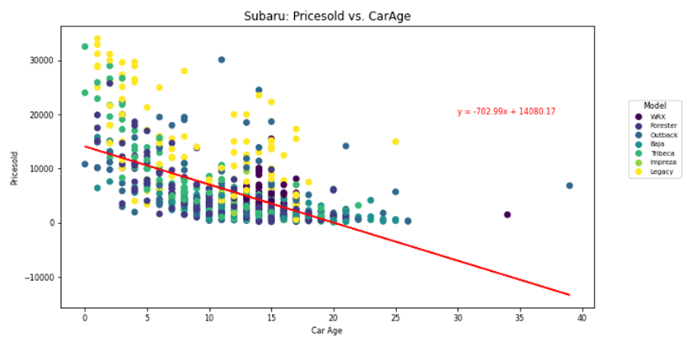
Factors Impacting Car Price – Model Level
Next: Analyzed the impact of mileage and age for a given car model
Within given car make – have many models
In general consumers would shop for a given make of car vs. comparing prices across all car makes.
Overall:
As mileage and car-age have a greater impact on price as we hold categorical factors such as make constant
Would expect relationship to improve if held model constant and regressed based on trim or car body type
Model | Rsquared: Miles | Rsquared: Age
Honda - Civic | 0.385832092 | 0.298262234
Honda - Accord | 0.415765708 | 0.456275329
Subaru - Legacy | 0.392658805 | 0.432230262
Jeep - Grand Cherokee | 0.546823107 | 0.620422876
Mercedes-Benz - E-Class | 0.388801739 | 0.366695095
Honda - Odyssey | 0.428455765 | 0.535974638
Subaru - Forester | 0.428455765 | 0.535974638
Subaru - Outback | 0.504928385 | 0.572176839
Audi - A4 | 0.395873479 | 0.476634982
Subaru - Impreza | 0.342827383 | 0.081149931
Mercedes-Benz - 300-Series | 0.161535186 | 0.066429019
GMC - Yukon | 0.603341128 | 0.694924053
Lexus - RX | 0.474903 | 0.681456
GMC - Sierra 1500 | 0.391127235 | 0.34583042
Mercedes-Benz - SL-Class | 0.203073392 | 0.002923099
Subaru - WRX | 0.562021807 | 0.406616394
Jeep - Wrangler | 0.453083077 | 0.510633188

Slide 7
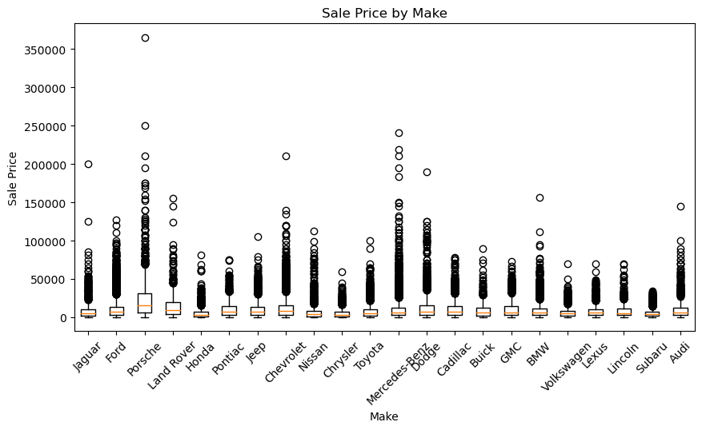

Box and Whisker Plot by Make

Slide 8
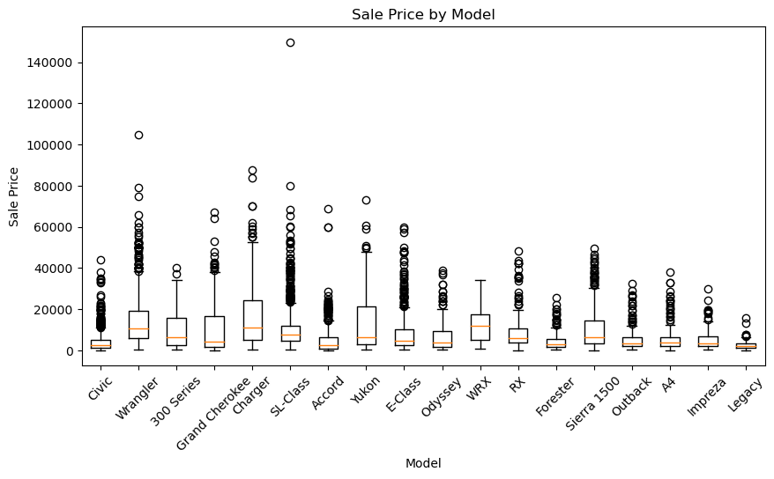
Box and Whisker Plot by Model
MODELS BY MEDIAN PRICE
$2,000-
Civic, Accord, Legacy
$3,000-$5,000
Grand Cherokee, E-Class, Odyssey, Forester, Outback, A4, Impreza
$5,000- $7,000
300 Series, Yukon, Serial 1500, RX, Sierra 1500
$7,000-$9,000
SL-Class
$10,000+
Wrangler, Charger, WRX

Slide 9
Value of cars over time – Scope
Year Made | <1970 | 1970-2001 | 2001-2010 | 2010-2015 | 2016 | 2017 | 2018 | 2019
Audi (A4) | - | 1,962 | 3,507 | 8,715 | 24,070 | 21,968 | - | 37,950
Chrysler (300 Series) | 10,529 | 1,420 | 5,055 | 13,265 | 18,720 | 19,887 | 20,239 | -
Dodge (Charger) | 23,293 | 9,476 | 4,420 | 12,556 | 26,063 | 29,809 | 29,303 | 36,564
GMC (Sierra 1500) | 5,895 | 4,732 | 6,369 | 16,924 | 29,079 | 26,661 | 32,264 | -
GMC (Yukon) | - | 3,579 | 5,456 | 17,318 | 36,137 | 34,285 | 43,217 | 46,214
Honda (Civic) | - | 2,293 | 2,463 | 7,558 | 9,608 | 15,353 | 19,041 | 19,900
Honda (Accord) | - | 1,211 | 2,921 | 8,350 | 14,710 | 15,222 | 18,598 | 20,200
Honda (Odyssey) | - | 1,403 | 3,440 | 11,665 | 16,374 | 25,000 | 29,373 | 32,833
Jeep (Wrangler) | - | 5,559 | 11,333 | 21,479 | 25,596 | 29,473 | 37,779 | 42,311
Jeep (Grand Cherokee) | - | 1,913 | 4,036 | 18,951 | 22,086 | 22,651 | 33,455 | 30,910
Lexus (RX) | - | 2,557 | 6,054 | 16,294 | 31,901 | 33,952 | 48,480 | -
Mercedes-Benz (SL-Class) | 38,180 | 7,475 | 11,567 | 30,353 | 37,357 | 37,600 | 6,060 | -
Mercedes-Benz (E-Class) | - | 3,731 | 5,444 | 17,910 | 27,974 | 35,000 | 47,370 | 33,953
Subaru (Forester) | - | 1,357 | 2,889 | 7,140 | 13,802 | 20,410 | 17,500 | -
Subaru (Outback) | - | 1,361 | 2,946 | 7,590 | 21,205 | 20,645 | 24,400 | 28,265
Subaru (Legacy) | - | 1,295 | 2,531 | 4,423 | - | 10,395 | 11,100 | -
Subaru (Impreza) | - | 3,365 | 4,111 | 8,666 | 5,377 | 11,320 | 10,155 | 5,405
Subaru (WRX) | - | 7,210 | 8,678 | 13,655 | 19,487 | 22,787 | 30,142 | -
Selected desired Make/Model
Established the bins to categorize the year make data
Retrieved only the cars sold in 2019 as the largest data pull
Calculated average price for each category

Slide 10
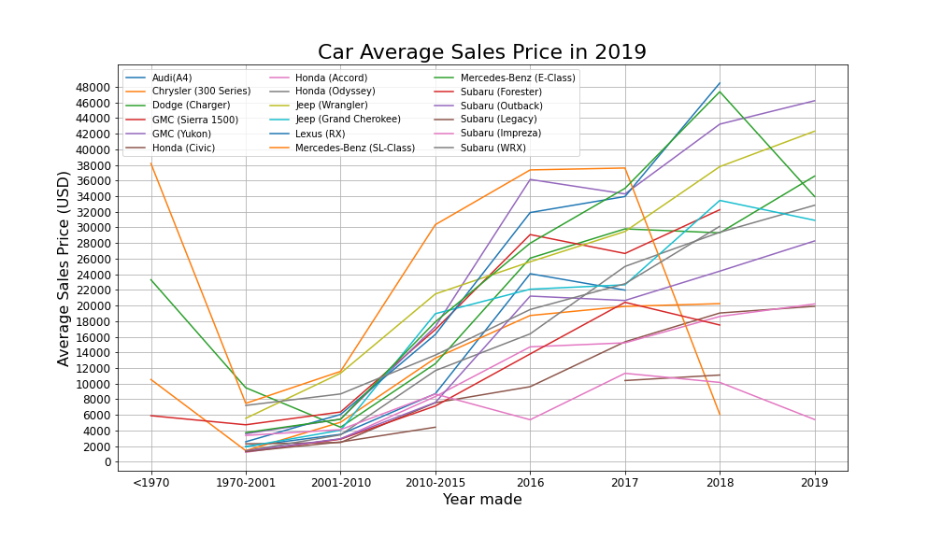
Value of cars over time – Outcome
Newer cars will depreciate with age, classic car values tend to appreciate due to supply and demand.
Used car price affected by age, mileage, overall condition.
Unable to identify specific trends that would influence the decision making.

Slide 11
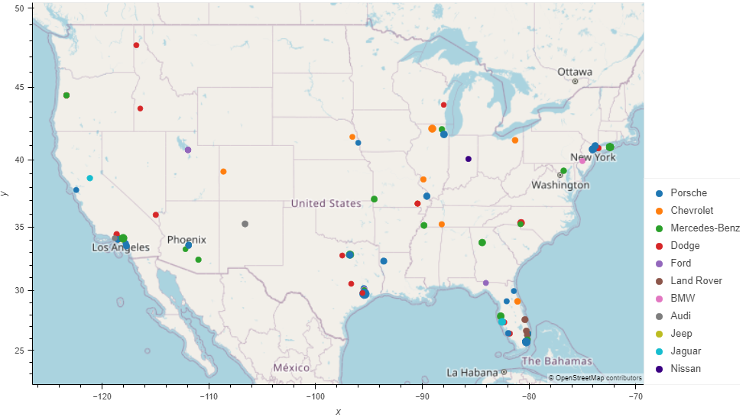
Did you know?
Luxury cars are also sold on eBay! Eighty-six cars sold on eBay between 2018 and 2020 with a price greater than $100K. Below is a view of where these sales occurred.
Interesting Facts
State with most luxury car sales: Florida (21)
Highest selling price: $365,000 (Porsche 911)

Slide 12
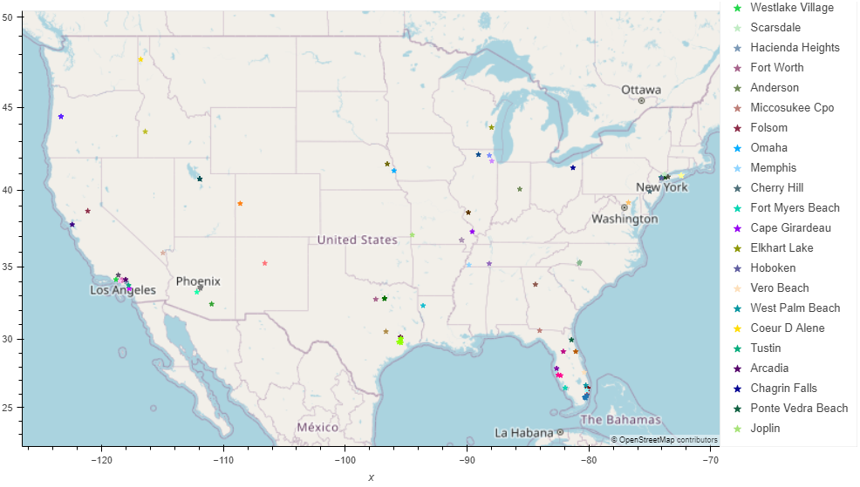
Geo”API”fy
To keep these luxury vehicles in pristine condition, the new owner is probably curious where to find the nearest repair shop. Using Geoapify’s API, we have located the nearest car repair shop to each of these sales based on zip code.

Slide 13
Conclusion
In conclusion, we were able to answer the three questions we asked going into this analysis:
Q1: What specifications of a car appear to have the largest impact on price?
Macro level – little to no correlation between mileage and age on a cars price
As you dive into make and/or model level, you begin to see moderate correlation.
Stronger r-squared metric dependent by model
Q2: What is the most commonly seen price point for certain cars?
Median price based on our dataset is $6,390, with the majority of cars below $2,500
Most Honda and Subaru models are priced on the lower end ($2000-$5000)
Q3: How does the value of car change over time? And are there any statistically significant differences between the trends of different makes and models?
No strong evidence to compare value delta across make or model
Macro level conclusion is that vehicles will depreciate over time with the exception of collector type models
A deeper analysis with a more advanced dataset would needed make conclusions based on specific make/models.

